Slide 1
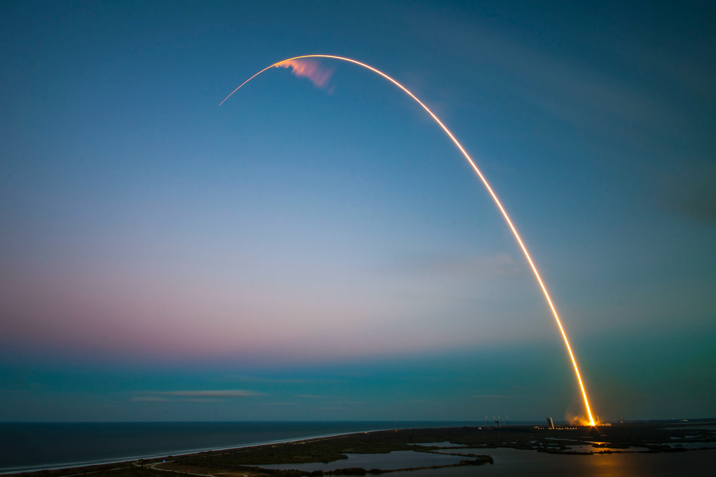
SpaceX Falcon 9
First Stage Landing Prediction
Farah Dahir

Slide 2
Outline
Executive Summary
Introduction
Methodology
Results
Conclusion

Slide 3
Executive Summary
Summary of Methodology
Summary of Results
Data Acquisition
Exploratory Data Analysis
Building an interactive map with Folium
Building a Dashboard with Plotly Dash
Predictive analysis (Classification)
Exploratory Data Analysis Results
Geospatial Maps
Interactive Dashboard
Predictive analysis Models

Slide 4
Introduction
Project Background
The cost of a Falcon 9 launch, at $62 million, is notably lower than competitors' offerings, which can exceed $165 million per launch. SpaceX's competitive advantage lies in the reusability of the first stage, resulting in significant cost savings compared to other providers in the space launch industry. This cost information can be invaluable for potential competitors looking to bid against SpaceX for rocket launch contracts.

Slide 5
Introduction
Key Questions to Address
The best way to estimate the total cost for launches, by predicting successful landings of the first stage of rockets.
How do variables such as payload mass, launch site, number of flights, and orbits affect the success of the first stage landing.
Where is the best place to make rockets launches.

Slide 6
Data Acquisition
Exploratory Data Analysis
Geospatial Analysis
Interactive Dashboard
Predictive Analysis
Methodology

Slide 7
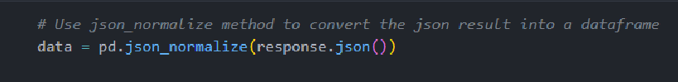
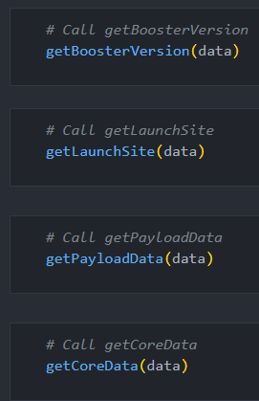
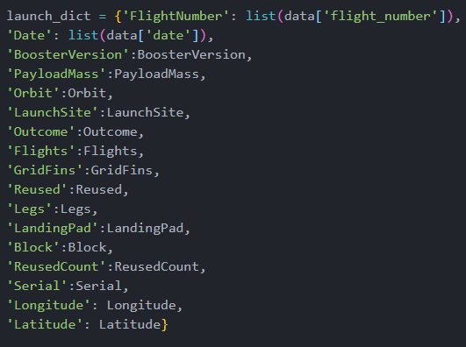
Data Acquisition
1
From SpaceX API:
Data was obtained from the SpaceX API. Filtered to obtain useful columns, filled missing values and Store the cleaned data in a CSV file.
GET request made to the API and response converted to a Pandas DataFrame.
Filtering the response and retaining only the Falcon 9 rocket launches and important columns.
Filling missing values in the ‘PayloadMass’ column using the mean value.
2
3
GitHub Link

Slide 8
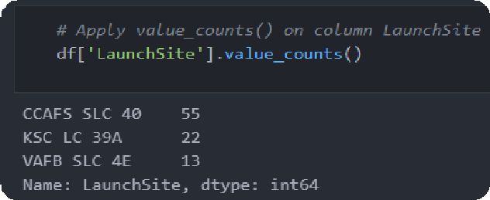
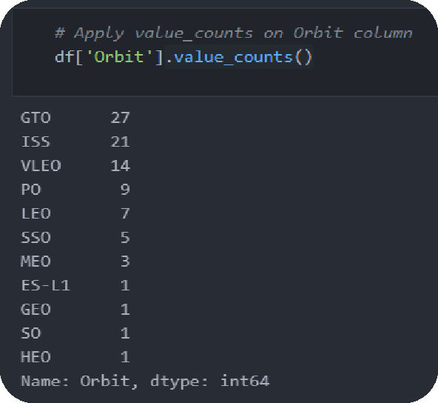
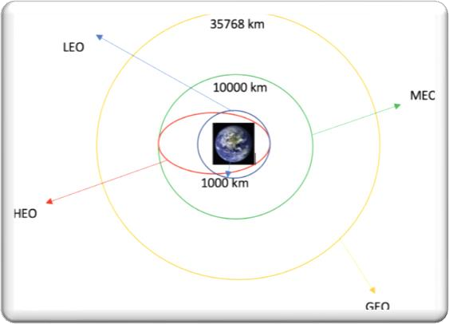
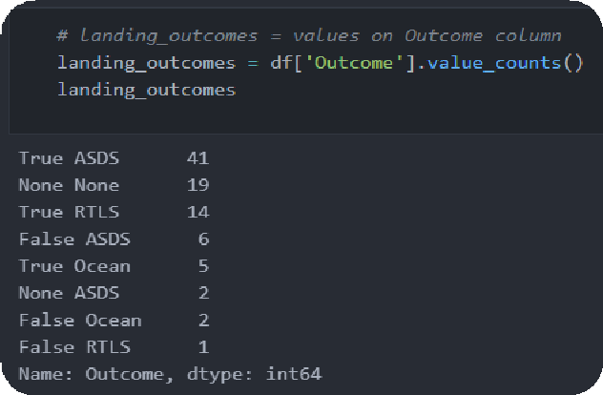
1
Exploratory Data Analysis
Using PANDAS:
The SpaceX dataset contains several Space X launch facilities, and each
location is in the LaunchSite column.
Each launch aims to a dedicated orbit, and some of the common orbit types are shown in the figure below. The orbit type is in the Orbit column.
2
3
Initial Data Exploration:
Using the .value_counts() method to determine the following:
Number of launches on each site
Number and occurrence of each orbit
Number and occurrence of landing outcome per orbit type
GitHub Link

Slide 9
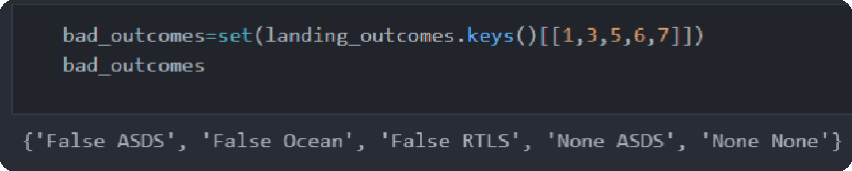
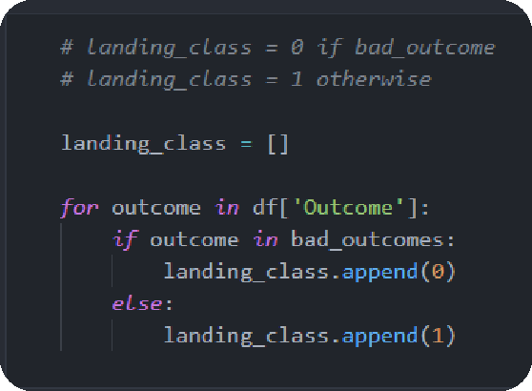

Exploratory Data Analysis
Labeling the Outcome:
To ascertain the likelihood of a successful booster landing, it is advisable to employ a binary column, denoted by values 1 or 0, to signify the outcome of the landing. This process involves:
Establishing a collection of unsuccessful outcomes termed as "bad_outcome.“
Generating a list, named "landing_class," where each element assumes the value 0 if the corresponding entry in the "Outcome" falls within the "bad_outcome" set; conversely, it takes on the value of 1 if it does not.
Constructing a "Class" column that incorporates the values derived from the "landing_class" list, effectively categorizing the outcomes as either successful (1) or unsuccessful (0) landings.
1
2
3
4
GitHub Link

Slide 10
Exploratory Data Analysis
SCATTER CHARTS
BAR CHART
LINE CHARTS
Scatter charts were used to visualize the relationships between:
A bar chart was used to visualize the relationship between:
Success Rate and Orbit Type
Line chart was produced to visualize the relationships between:
Flight Number and Launch Site
Payload and Launch Site
Orbit Type and Flight Number
Payload and Orbit Type
Success Rate and Year (i.e. the launch success yearly trend)
GitHub Link

Slide 11
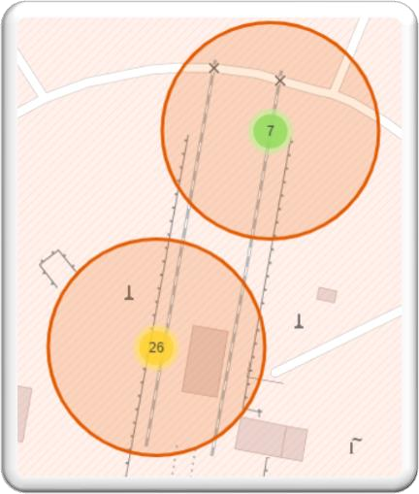
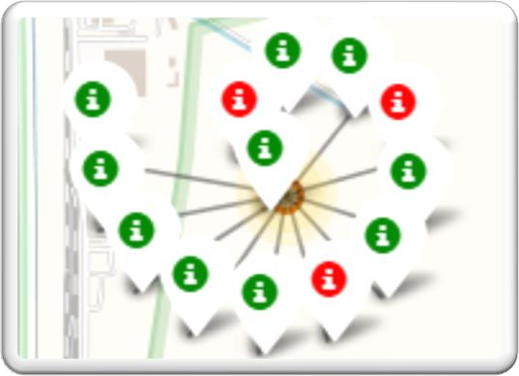
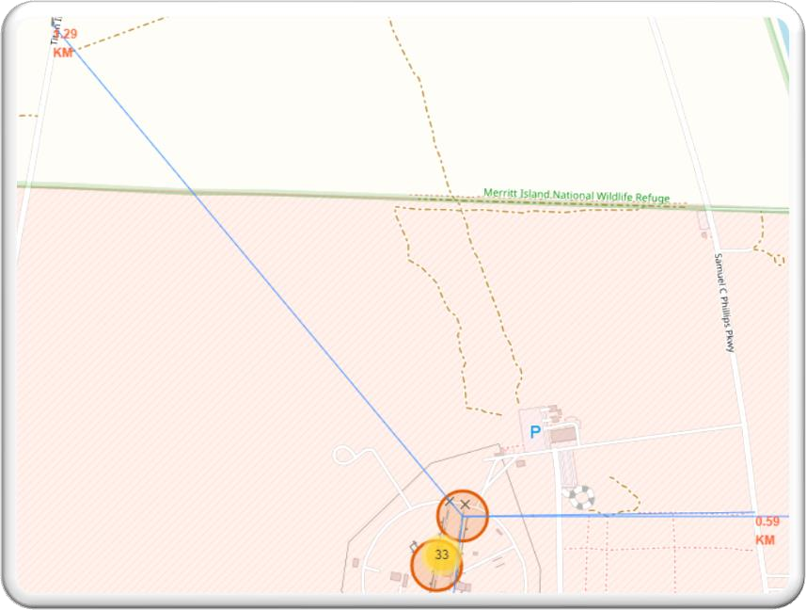
Geospatial Analysis
1
Using Folium:
Circles, Markers and lines were drawn on Folium Maps:
Used circles to indicate highlighted areas around specific coordinates, like NASA Johnson Space Center;
Added colored markers of successful (green) and unsuccessful (red) launches at each launch site to show which launch sites have high success rates
Added coloured Lines to show distances between Launch Site and its proximities like Railway, Highway, Coastline and Closest City.
2
3
GitHub Link

Slide 12
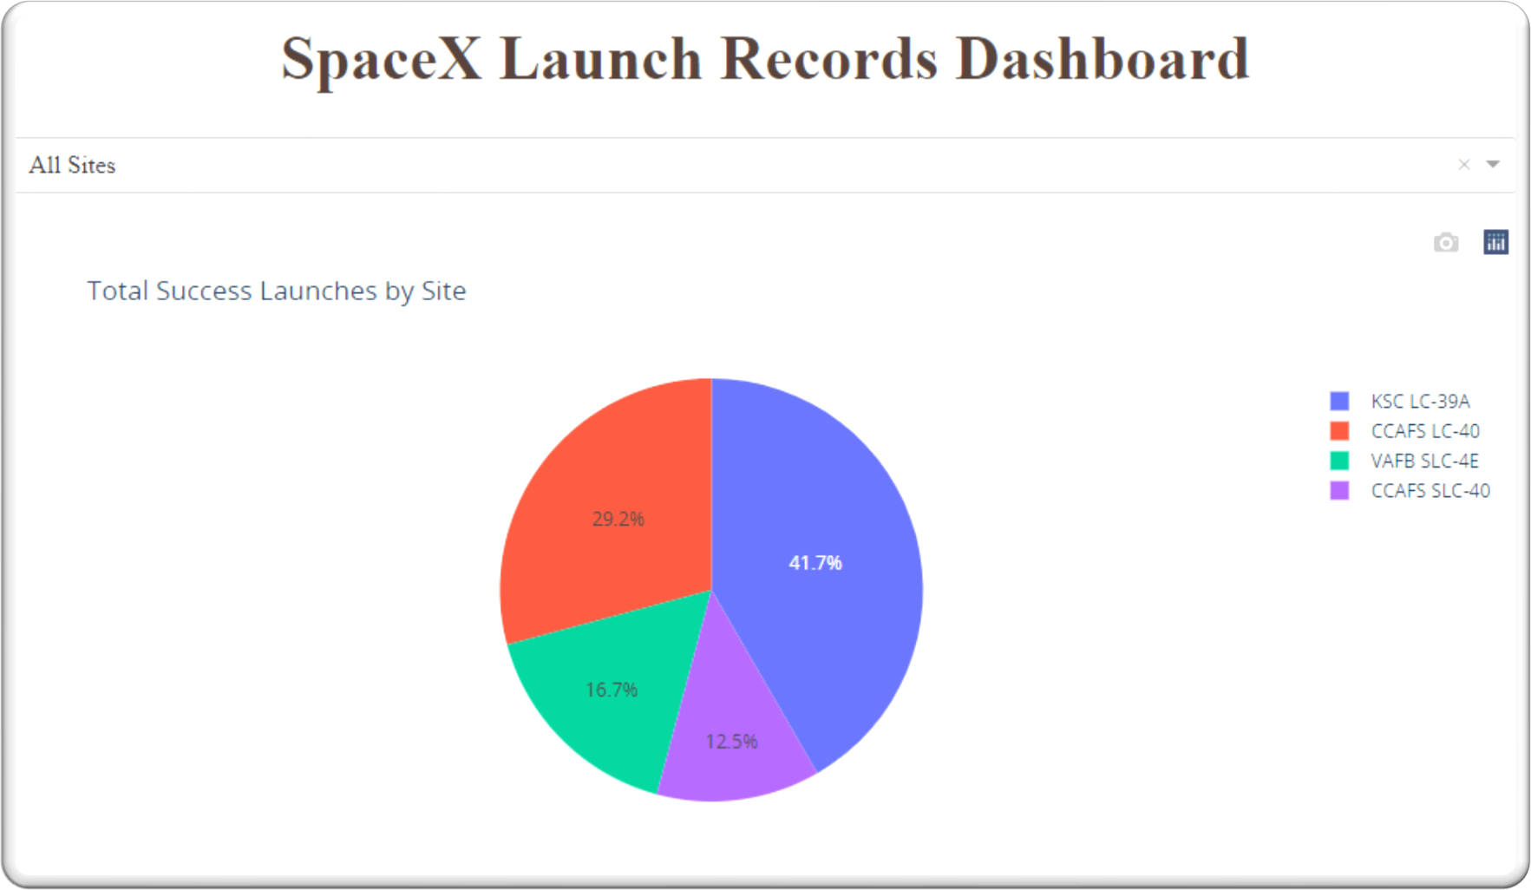
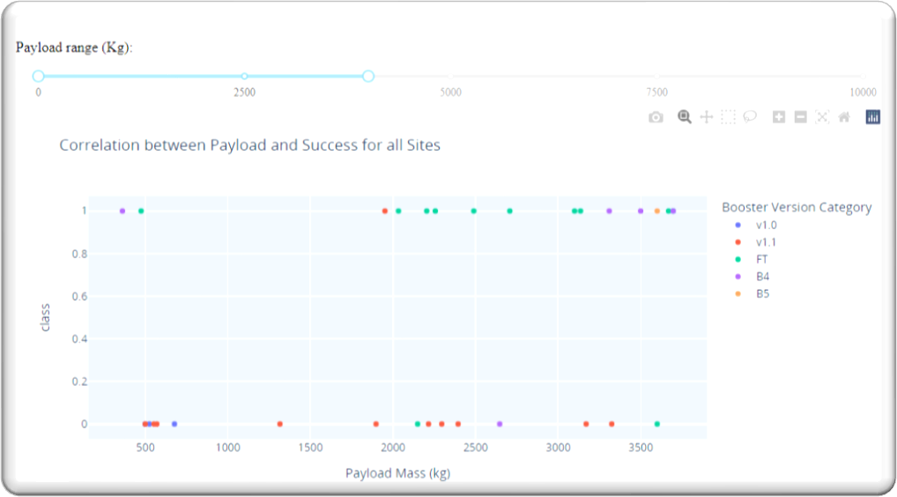
Interactive Dashboard
1
Using Plotly Dash:
A dropdown list was used to enable Launch Site selection, pie chart for Success Launches of all sites and a Slider of Payload Mass Range:
Added a pie chart to show the total successful launches count for all sites and the Success vs. Failed counts for the site, if a specific Launch Site was selected.
Used Scatter Chart to show correlation between Payload Mass and Success Rate for different Booster Versions.
2
GitHub Link

Slide 13
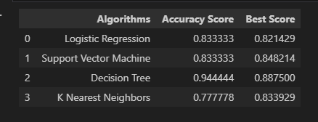
Predictive Analysis
1
ML Classification Models:
The following steps were taking to develop, evaluate, and find the best performing classification model:
Standardize the data with StandardScaler. Fit and transform the data.
Split the data using train_test_split
Create a GridSearchCV object with cv=10 for parameter optimization
Apply GridSearchCV on different algorithms: logistic regression, support vector machine, decision tree and KNN
Calculates accuracy scores and compared to Identified the best model for the project.
GitHub Link

Slide 14
EDA Results
Interactive Analytics
Predictive Analysis
Results

Slide 15
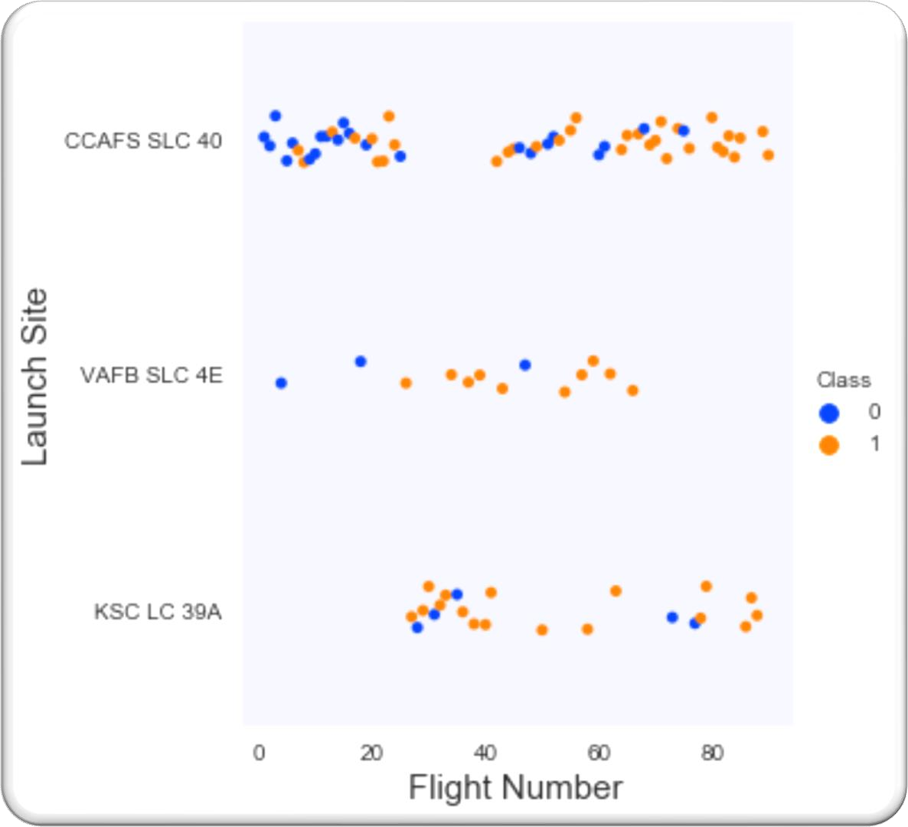
EDA Results
Launch Site Vs. Flight Number
Scatter plot of Launch Site vs. Flight Number
Flight numbers less than 30 were generally unsuccessful. Can be seen in sites CCAFS SLC 40 and VAFB SLC 4E.
The CCAFS SLC 40 launch site has about half of all launches.
VAFB SLC 4E and KSC LC 39A are the sites that have higher success rates.
Above flight number of 80, there is a 100% success rate for sites CCAFS SLC 40 and KSC LC 39A.

Slide 16
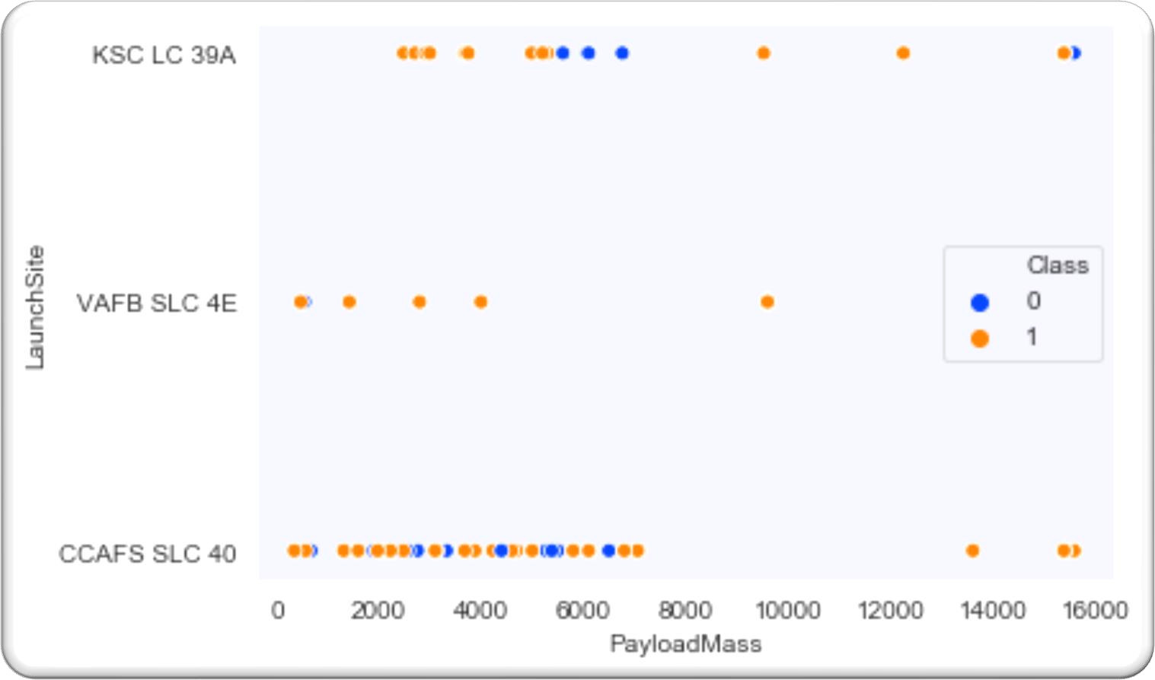
EDA Results
Launch Site Vs. Payload Mass
Scatter plot of Launch Site vs. Payload Mass
KSC LC 39A has a 100% success rate for launches less than 5,500 kg.
Most of the launches from CCAFS SLC40 are of lighter payloads (with some outliers).
Most launces with a payload greater than 7,000 kg were successful.
For VAFB-SLC there are no rockets launched for heavy payload mass(greater than 10000).

Slide 17
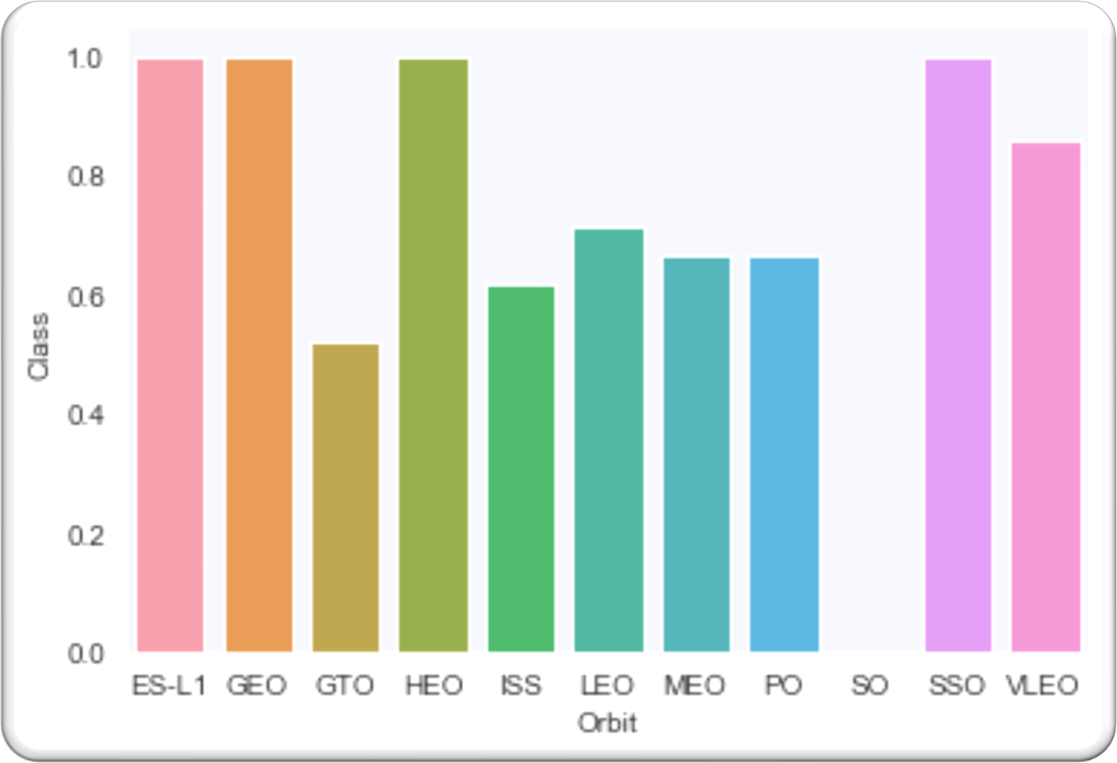
EDA Results
Success Rate Vs. Orbit Type
Bar chat of Success Rate vs. Orbit Type
Orbits with 100% success rate:
ES-L1, GEO, HEO and SSO
Followed by VLEO (above 80%);
The orbit with the lowest (0%) success rate is SO

Slide 18
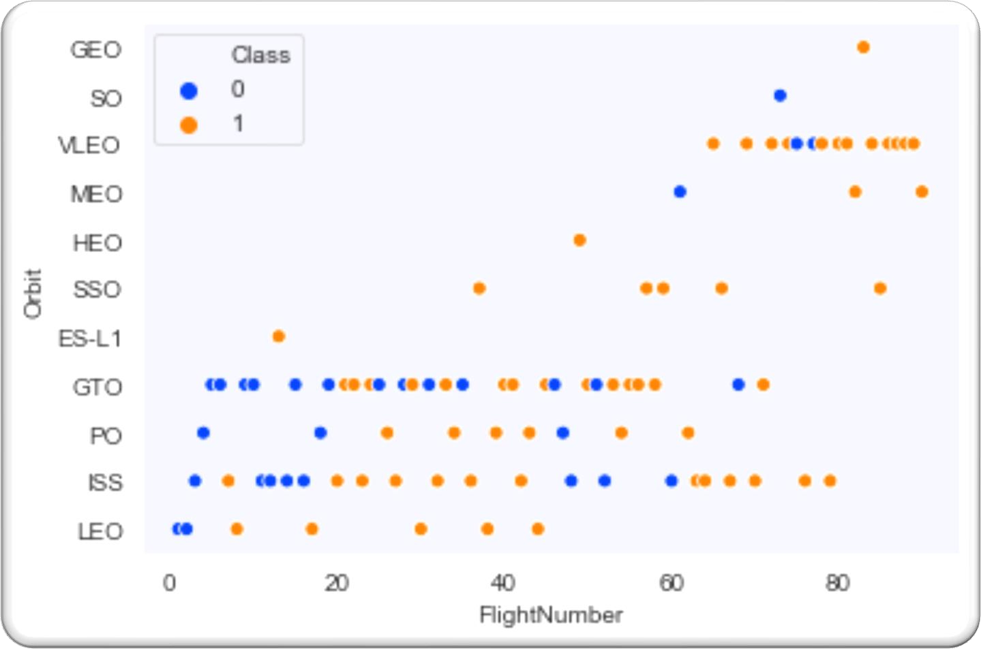
EDA Results
Orbit Type Vs. Flight Number
Scatter plot of Orbit Type vs. Flight Number
In the LEO orbit the Success appears related to the number of flights; on the other hand, there seems to be no relationship between flight number when in GTO orbit.
GEO, HEO, and ES -L1 only had 1 flight each which were all successful
100% success rate in SSO

Slide 19
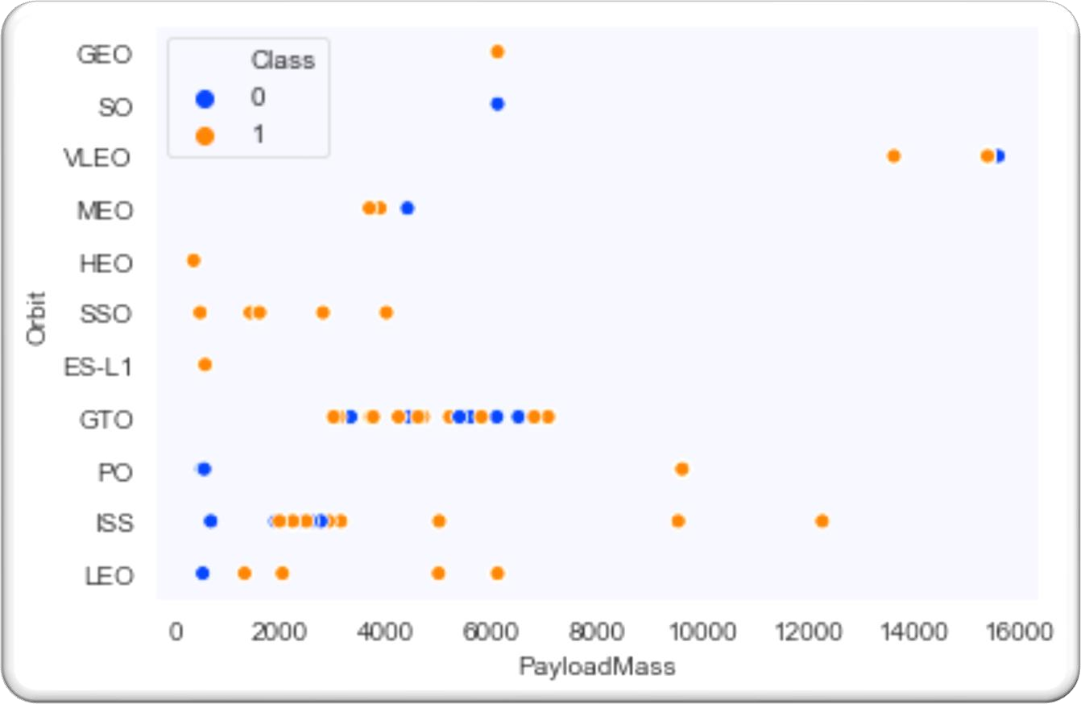
EDA Results
Orbit Type Vs. Payload Mass
Scatter plot of Orbit Type vs. Payload Mass
With heavy payloads the successful landing rate are more for PO, LEO and ISS.
However for GTO we cannot distinguish this well as both successful and unsuccessful landings are mixed up with an increase in payload Mass.
ISS has the widest range of payload and about 67% success rate.

Slide 20
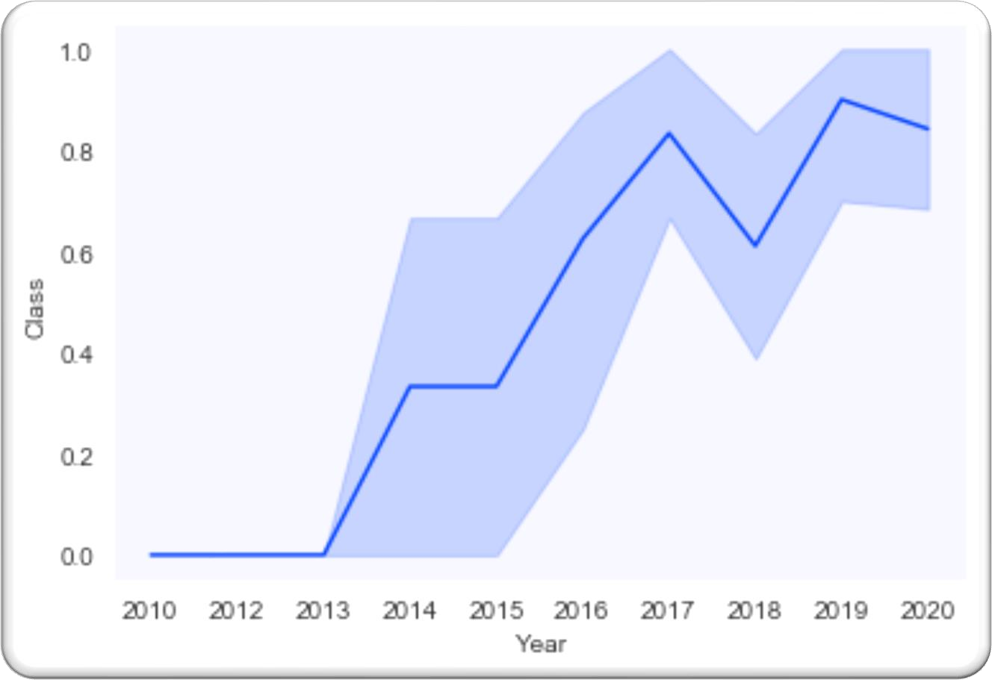
EDA Results
Launch Success Yearly Trend
Line chart of launch success for 2010-2020
First 3 years (2010-2013), all landings were unsuccessful.
From 2013 success rate kept increasing till 2020.
From 2016 onwards, there was always more than a 50% chance of success.

Slide 21

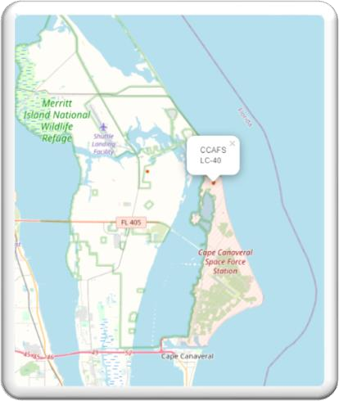
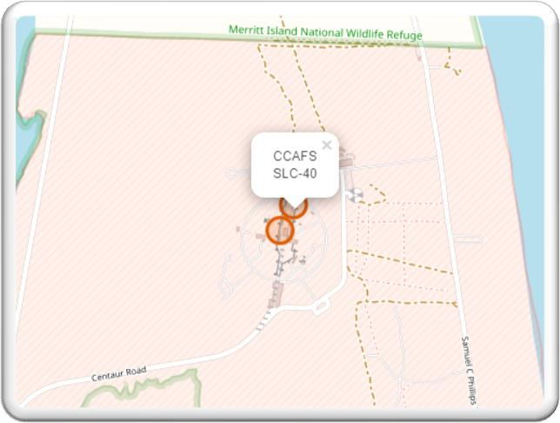
Interactive Analysis (Folium)
All Launch Sites
All sites are close proximity to the coast. Most of Launch sites are in proximity to the Equator line and rockets launched from these sites get an additional natural boost due to the rotational speed of earth.

Slide 22
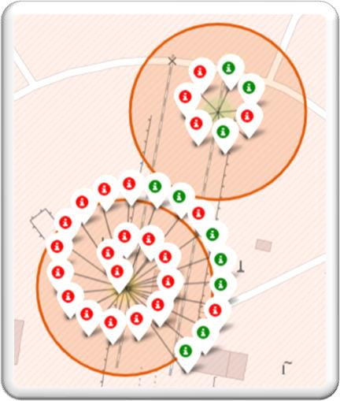
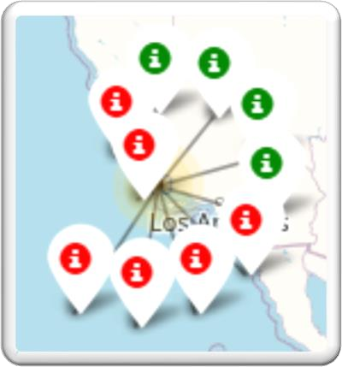
Interactive Analysis (Folium)
Launch Outcomes by Site
Green markers indicate successful and red ones indicate unsuccessful launches.
Launch Site KSC LC-39A has a very high Success Rate.
CCAFS SLC-40 and CCAFS LC-40
VAFB SLC-4E
KSC LC-39A

Slide 23
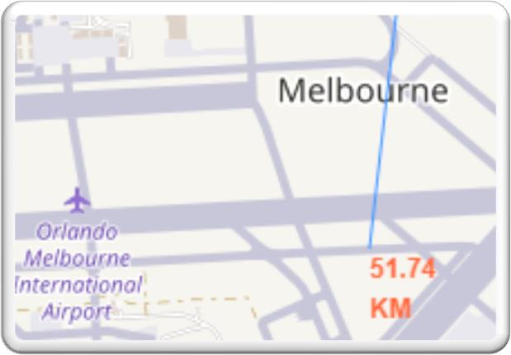
Interactive Analysis (Folium)
Distance to Proximities
This shows distance proximities of the CCAFSSLC-40 launch site as an example and it can be see that it is:
Close to railway (1.29 km)
Close highway (0.29 km)
Very far from the nearest city (51.74 km)
1
2
3

Slide 24
Interactive Analysis (Plotly Dash)
Launch Success by Site
Total Success Launch by Site
KSC LC-39A has the most successful launches amongst launch sites (41.2%)

Slide 25
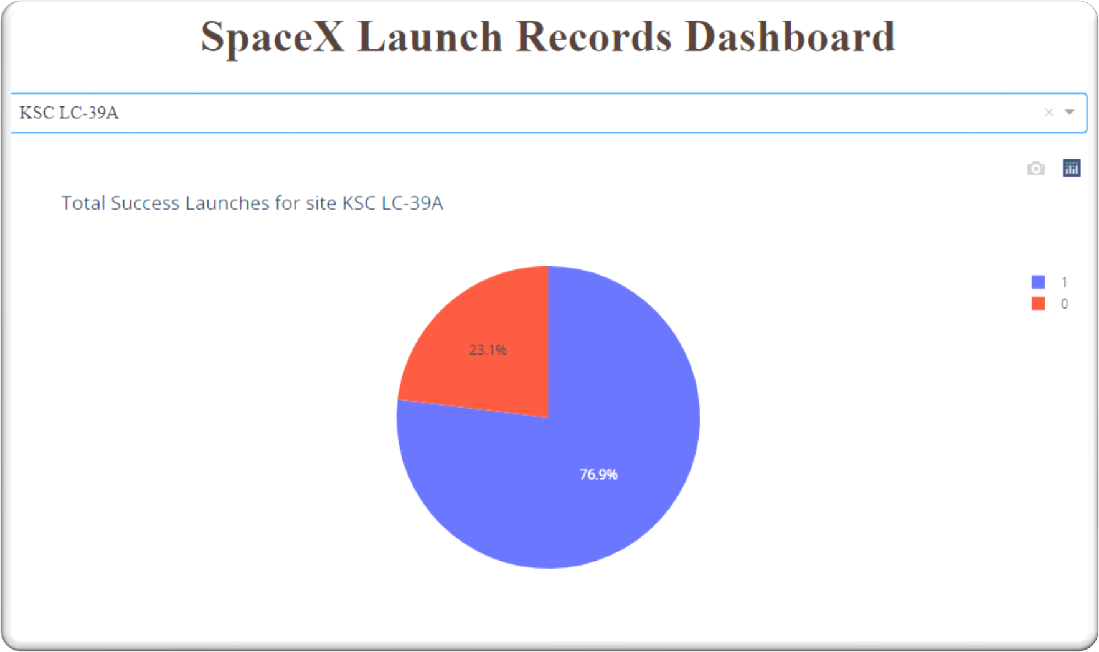
Interactive Analysis (Plotly Dash)
Highest launch success ratio
Total Success Launch for KSC LC-39A
KSC LC-39A has the highest launch success rate (76.9%) with 10 successful and only 3 failed landings.

Slide 26
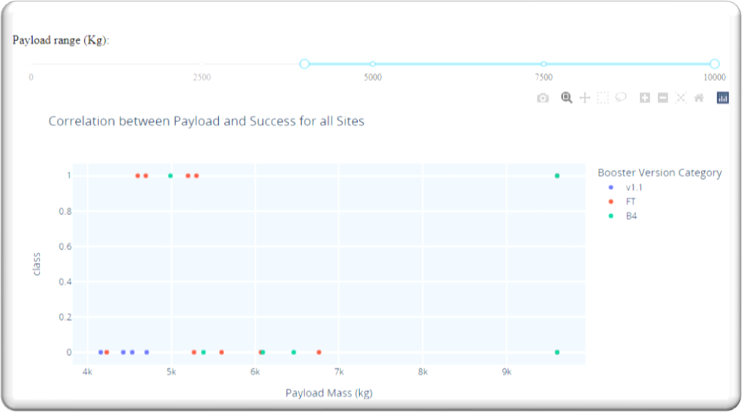
Interactive Analysis (Plotly Dash)
Payload vs. Launch Outcome
1
Correlation between Payload and Landing
Payloads between 2,000 kg and 4,000 kg (low payload) have the highest success rate.
Payloads of 4,000-10,000 (massive payload), have less success rate.
2

Slide 27
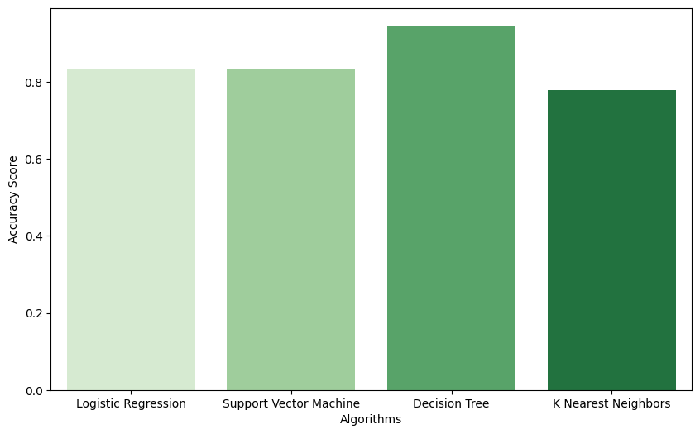
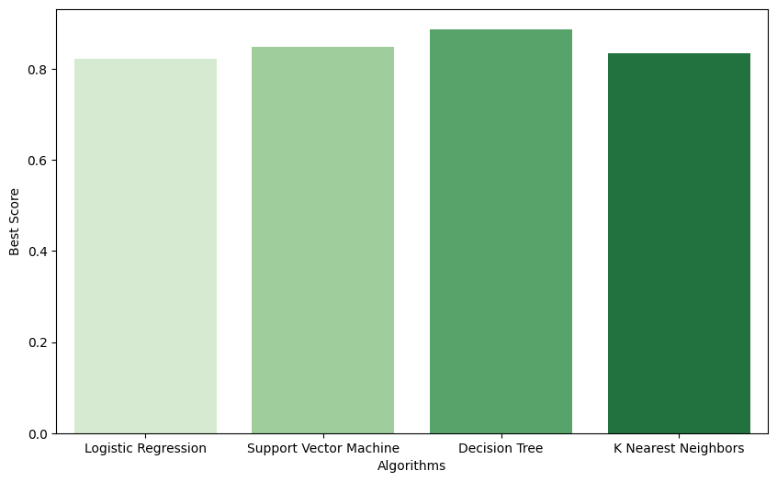
Predictive Analysis
Classification Accuracy
Accuracy Score
The model with the highest accuracy was Decision Tree Classifier, which had an accuracy_score of 0.94 and a best_score of 0.89 after hyper-parameter tuning.

Slide 28
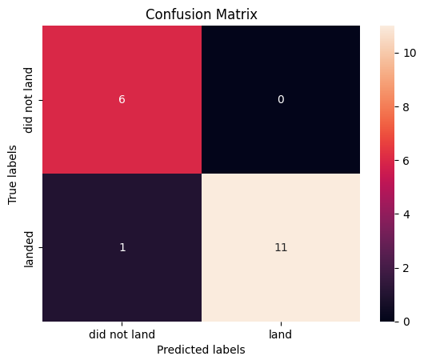
Predictive Analysis
Confusion Matrix
True +ve/–ve VS False +ve/-ve
The confusion matrix of the Decision Tree Classifier shows only 1 out of 18 total results classified incorrectly (a false negative, shown in the bottom-left corner). The other 17 are correctly classified (6 did not land, 11 did land).

Slide 29
Conclusion

Slide 30

Conclusion
Most of the launch sites are near the equator for an additional natural boost - due to the rotational speed of earth, which helps save the cost of putting in extra fuel and boosters.
The success rate of launches increases over the years.
The launch site KSCLC-39 A had the most successful launches, with 41.7% of the total successful launches, and also the highest rate of successful launches, with a 76.9% success rate.
Launches with a low payload mass (less than 4,000)show better results than launches with a larger payload mass.
Orbits ES-L1, GEO, HEO, and SSO have a 100% success rate
Decision Tree Classifier can be used to predict successful landings hence estimate the total cost for a launch.

Slide 31
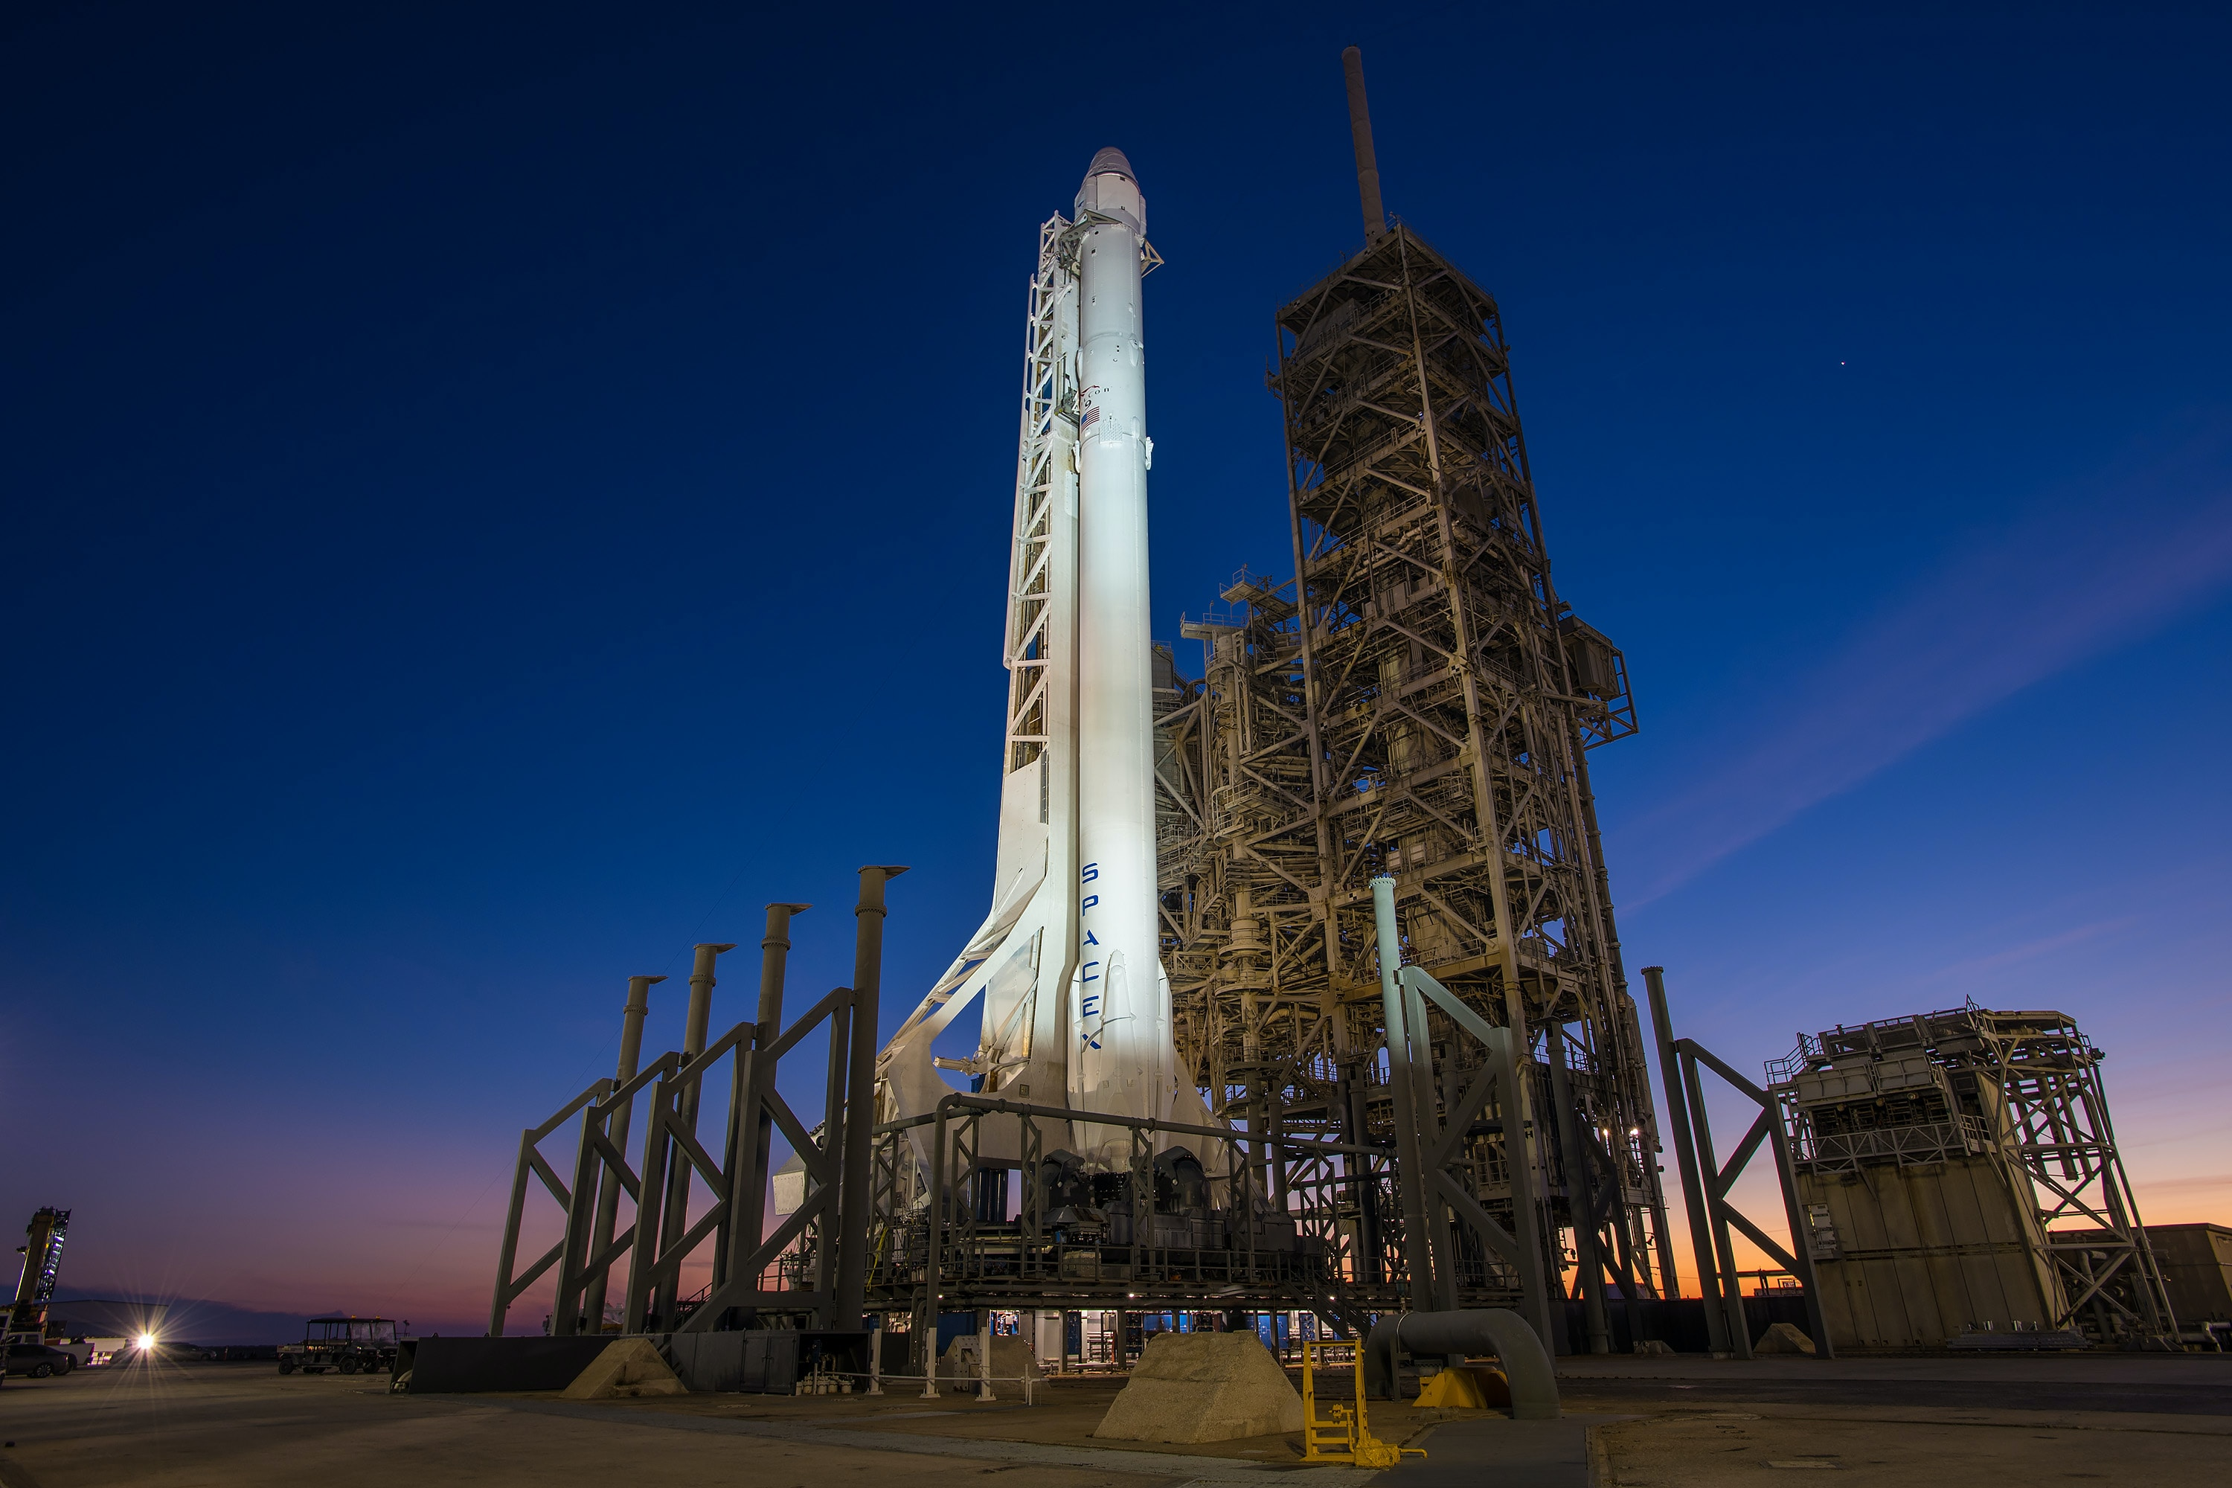
THANK YOU!

